Slide 1
API Naming Strategy and Convention

Slide 2

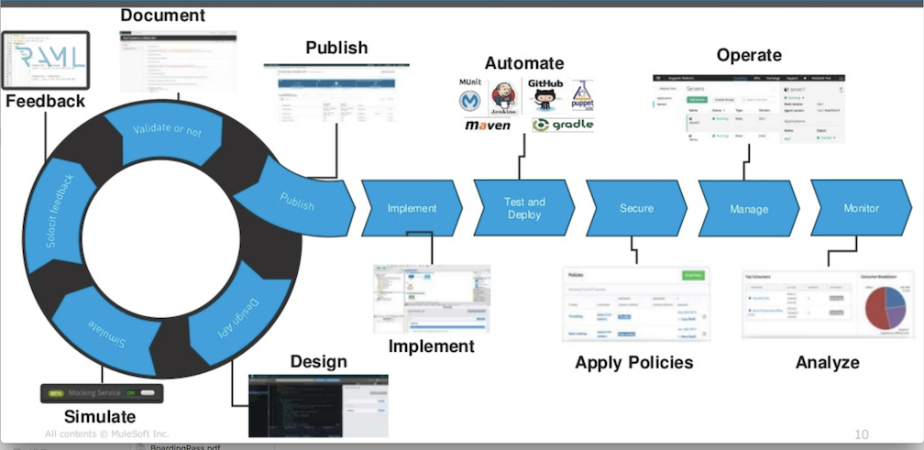
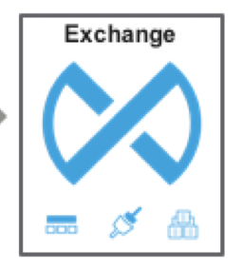


Add API Discovery Phase to the lifecycle
New API Required
LOB Team
Is there an existing API asset?
NO
YES
API Discovery Phase Workflow
Engage Track Lead / Domain Expert
Engage Enablement Team
Domain and API naming Discovery
Engage API Owner team and facilitate
Add Discovery Phase to the lifecycle
Start with API Discovery process before executing full API Lifecycle
Execute Full API Lifecycle
Establish Relationship
(Conformant / Partnership / customer - supplier)
Engage enablement Team to evaluate re-use potential
Capture required API Contract and NFRs
Publish it as Enterprise asset to marketplace
Capacity planning and Execution

Slide 3
Naming Convention for API Applications
Objective: Establish Naming Convention that gives uniqueness and intuitiveness to the APIs and when followed along with API Lifecycle avoids duplicates and fosters reusability
Approach: API Naming Convention based on Business Capability Domains + API-Led
API Naming Considerations
Business Variables
Domain Object / Entity Mapping
Source System of record
API Consumers (Internal, External, Partners)
Data Sensitivity (Public, Private, Restricted)
API Design Variables
API Layer (Sys, Pro, Exp)
API Type (REST, HTTP, SOAP)
API Category: API Proxy, Mule-API, Non-mule APIs
Platform Components
Design Center Project
Exchange Asset
API Manager Entry
Deployment Artifact (Runtime Manager)
API URL
Server Name
** Elements that can’t be reflected in naming convention, add those as exchange tags / categories

Slide 4
Domain Driven vs System Driven: Guidelines
Domain Driven Approach
Recommended
Business API names should reflect the domain object (and optionally sub-domain) it’s related with.
Naming Pattern: “{domain}-{sub-domain}-api”.
API-Led Layers: This approach is applicable for all the API layers (System, Process and Experience)
“customer-profile-api”
Get-CustomerProfile-api
“finance-report-api”
“report-processing-api”
“accounts-invoice-api”
“invoice-generation-api”
System Driven Approach
For scenarios where canonical data model is not established, there is possibility of multiple forms of same object from different source systems. To establish uniqueness of the API names, the recommended pattern in such scenarios, is to associate the domain name with the system of records
Naming Pattern: “{system of record}-{domain}-{sub-domain}-api” (e.g sfdc-accounts-api, sap-accounts-api, sfdc-employee-profile-api, netsuite-employee-profile-api).
Disadvantage of this approach is that the API design is tightly coupled to backend system and in scenarios when the backend system is replaced the API has no existence
API-Led Layers: This approach is generally applicable to system layer APIs

Slide 5
Domain Identification: Canonical vs Bounded Context
Canonical Data Model
Bounded Context
There is exactly one canonical definition of each data type, which is reused in all APIs that require that data type.
E.g. One definition of Invoice that is used in the enterprise across all business verticals like Fuels-Lube, Finance, Upstream
In such scenarios the domain object is unique in itself and the API name can just follow the pattern: {domain}-api, e.g. “invoice-api”, “accounts-api”, “etc.
Canonical Data Models, although a seemingly attractive idea, are often not successful, especially in age of microservices
However, if a successful canonical Model exists, then all Process APIs and System APIs should reuse that wherever possible
Each Bounded Context has its own, distinct set of data type definitions. The Bounded Context Data Models of separate Bounded Contexts are formally unrelated, although they may share the same names.
e.g.: Accounts bounded context has a distinct definition of Invoice that is formally unrelated to the definition of Invoice in Finance Bounded Context
In such scenarios the API name should include both domain name and the bounded context to establish uniqueness:
{bounded-context}-{domain}-api;
e.g: “finance-invoice-api”, “accounts-invoice-api”
It is most pragmatic to use Bounded Context Data Models

Slide 6
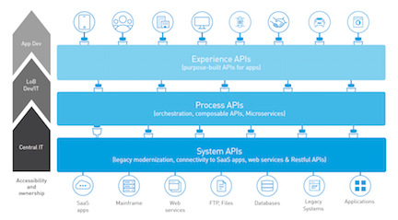
API Layer in API Naming
Experience API: add –exp- OR reference of the consumer channel in-place like “mobile”
{domain}-{consumer-channel}-api
e.g: customer-profile-mobile-api or customer-profile-exp-api
Process API: add -proc-
{domain}-{sub-domain}-proc-api
System API: add -sys-
{domain}-{sub-domain}-sys-api
OR
{system of record}-{domain}-sys-api

Slide 7
API Naming Pattern across Anypoint Components
Component | Naming Pattern | Example
Design Center | lower case, hyphen {domain}-{subdomain}-{layer}-api | customer-profile-sys-api
API Manager, Exchange | Upper Case, no hyphen Domain Sub-Domain System API | Customer Profile System API
Runtime Manager | lower case, hyphen {domain}-{subdomain}-{layer}-api-majorVersion | customer-profile-sys-api-v1 customer-profile-sys-api-v2
API Manager, Exchange (for API Proxy) | add –proxy- {backend-api-name}-proxy-api | finance-invoice-proxy
App URL | /{domain}-{subdomain}-{layer}-api/{version}/ | /customer-profile-sys-api/v1/

Slide 8
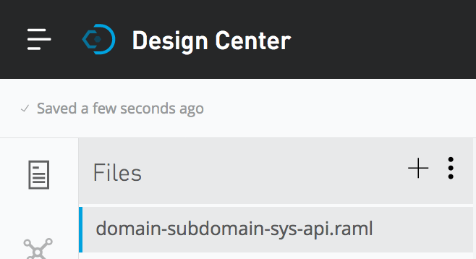
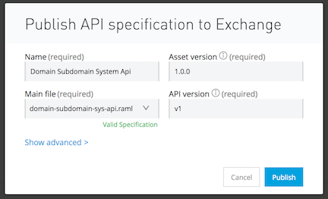
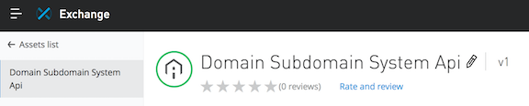
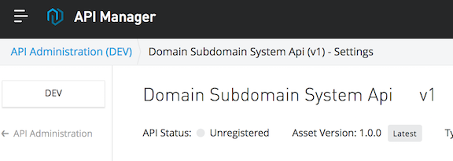
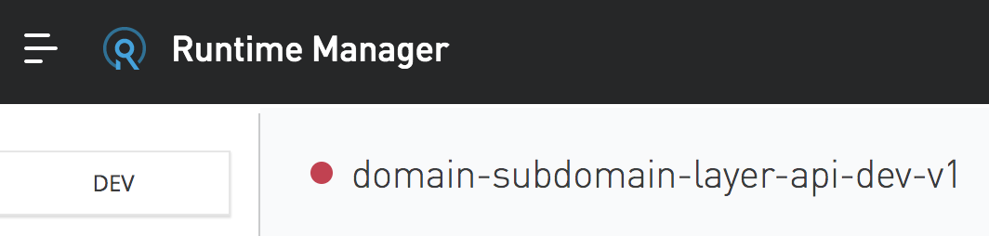
API Naming Pattern across Anypoint Components
In Application Deployment name (shown in Runtime Manager), add –env- when using shared infrastructure (application namespace) across multiple SDLC environments like Dev, QA, Acc

Slide 9
Questions?

